Slide 1

IOT Road Monitoring
By Mubashir Hussain & Sarmad Alvi

Slide 2
Road Monitoring
Need vast amounts of data to plan road works and allocate budget (12% of city budget)
Currently city uses a variety of methods to monitor traffic and road conditions
Cameras
Radars
GPR
Every few years
Data used to set timings on traffic lights, plan construction, set speed limits etc.

Slide 3
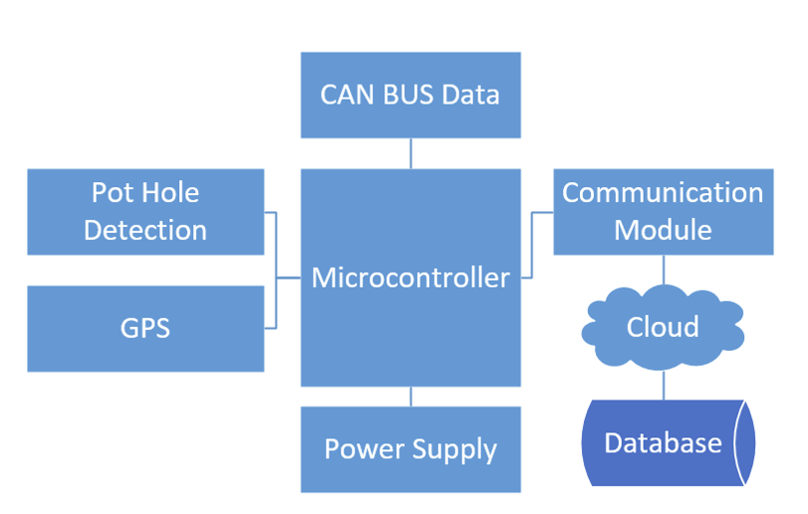
OuR Solutions
Use various modules to record relevant data
Vehicle speed & traction control via CAN Bus
Pot Holes via accelerometer
Vehicle position via GPS module
Send data using 4G to a server and record data in SQL database
Display road condition on a website for public use
Database used by municipality to do data analysis
Fit easily within a car

Slide 4
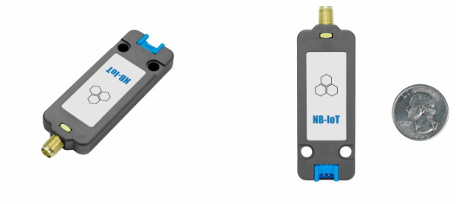
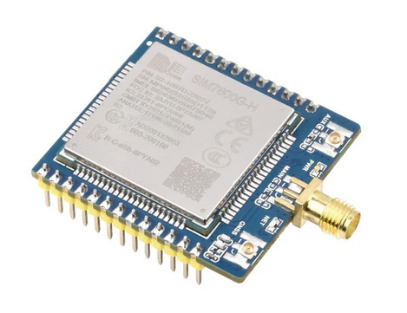
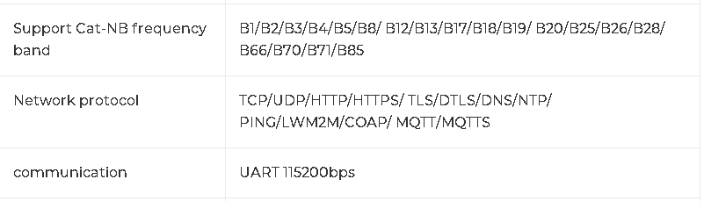
Communication module
NB-IOT SIM7020G – 50$
SIM7600G-H – 130$

Slide 5
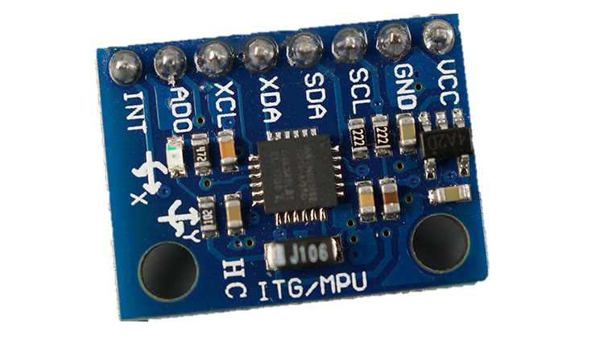
Pot-hole detection
Device Alternatives: None, we aim to use accelerometer on an IMU (Inertial measurement unit)
Algorithm Alternatives
Thresholding algorithm
Neural network algorithm
MPU-6050

Slide 6
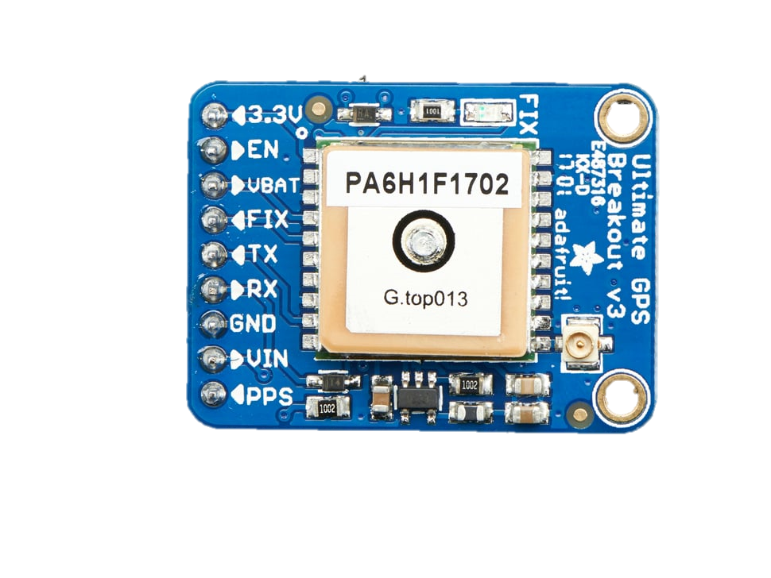
Gps
UART GPS module
1.8 m accuracy
0.1 m/s accuracy
22 tracking, 66 searching satellites
Require accurate location, stationary and moving, small size, power requirement
Alternative is assisted GPS (using cell towers) but it costs data to use

Slide 7
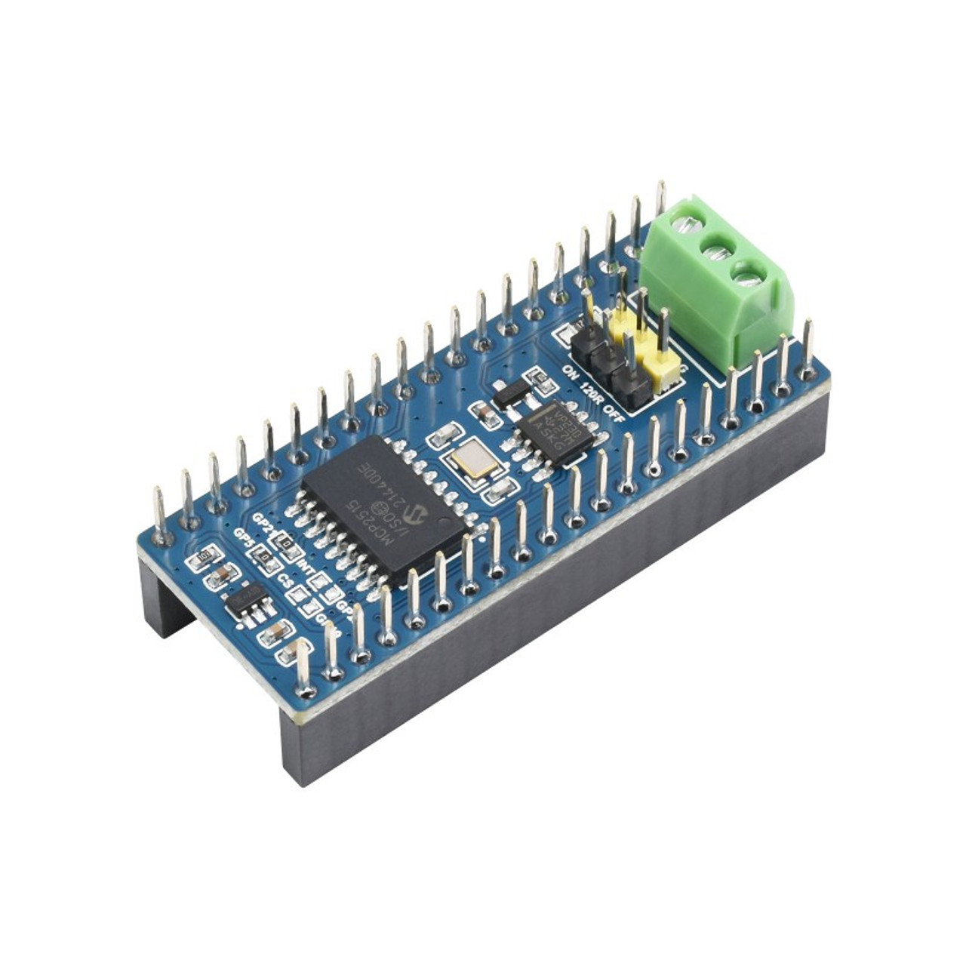
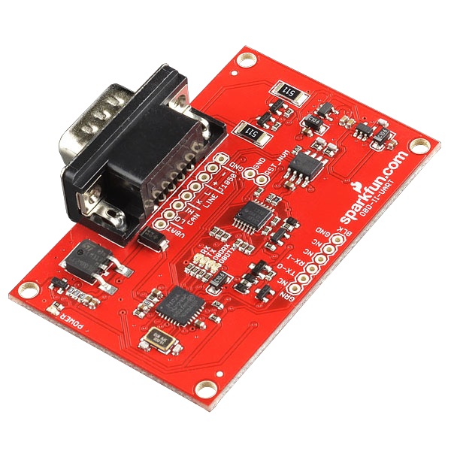
Can buS
CAN Bus module made for Raspberry Pi Pico
Built in CAN controller and transceiver
Supports multiple versions of CAN
Communicates over SPI
Alternative is a OBDII UART board
Supports multiple standards used in cars (CAN BUS, K-Line, etc.)

Slide 8
Division of labor
Mubashir Hussain
Communication Module
Pot hole detection
PCB
Sarmad Alvi
GPS
Can Bus
Back end (Database)

Slide 9
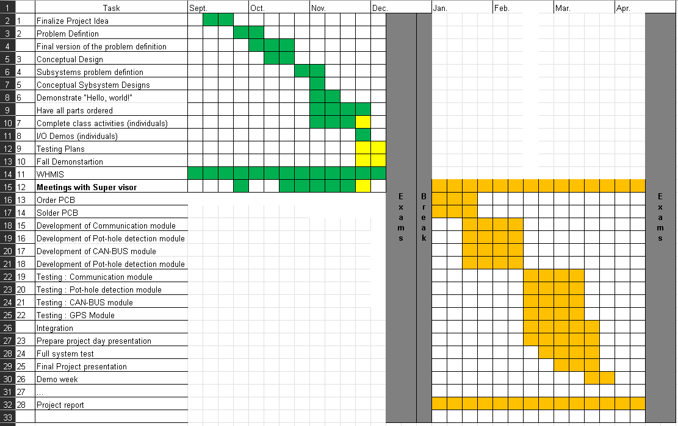
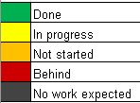
Gantt chart

Slide 10
Test plan
Communication Module: Connect to internet and ping public websites (ex. Google.ca) and send HTTP requests
Pot-hole detection Module: Manual hand testing to make certain peaks are responded to, calibrate sensor using actual road
GPS Module : Connect to satellites and get valid connection
Can-bus Module: Use simulated CAN data to test CAN module then test on a real car

